Slide 1
Rue the ROOs:
Rules of Origin and the Gains (or Losses) from Trade Agreements
Alan V. Deardorff
University of Michigan

Slide 2
The Issue
Can the proliferation of FTAs be harmful?
Trade diversion suggests that
  Individual FTAs could lower world welfare,
  But if FTAs became ubiquitous, that would not happen.
    If every country were to have an FTA with every other country, then there would be no trade diversion.
  Examples:
    US-Singapore 2004
    Singapore-Korea 2006
    US-Peru 2009
    Singapore-Peru 2009
    Korea-Peru 2011
    US-Korea 2011

Slide 3
S. Korea
U.S.
2011
2004
2009
2006
2011
2009
Singapore
Peru

Slide 4
China
2009
2008
2001
Singapore
New Zealand

Slide 5
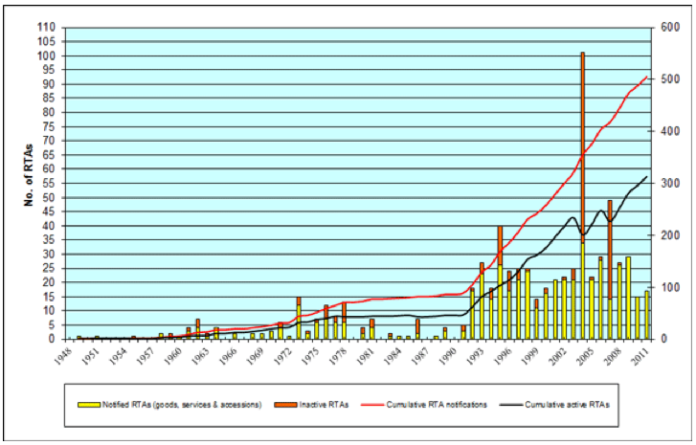
Notes:
http://www.wto.org/english/tratop_e/region_e/regfac_e.htm

Slide 6
The Issue
But that is accurate only for final goods
I will argue, via simple theoretical examples, that the presence of binding rules of origin (ROOs), in a world of traded intermediate inputs…
  Can increase protection on intermediate inputs above even the tariffs on final goods.
  Will reduce world welfare below that of global free trade, even if every country has an FTA with every other country.
  May even reduce every country’s welfare below what it would have achieved with no FTAs at all and positive tariffs.
  That is: All FTAs can be worse than No FTAs!

Slide 7
Rules of Origin
Why an FTA must have ROOs
  Countries’ external tariffs differ
  Without ROOs, goods will enter through the lowest-tariff country
ROOs specify
  Requirements for goods to be considered as “originating” either in a country or in an FTA
  Only trade satisfying the ROO gets a zero tariff

Slide 8
Rules of Origin
Types of ROOs
  Substantial transformation
    Change of “tariff heading”
      The fewer the digits, the more restrictive.
    Regional value added
      Minimum % from inside
      Maximum % from outside
  Technical rules
    E.g., “yarn forward” for textiles in NAFTA

Slide 9
Rules of Origin
Originating where? The issue of “cumulation”
  Bilateral cumulation: Inputs only within the FTA count, regardless of other existing FTAs
  Diagonal cumulation: Inputs from selected other countries count (such as other FTA partners)
  Full cumulation: Once a good satisfies a ROO, its full value is counted as originating
In practice, many FTAs (and all involving the U.S.) use bilateral cumulation
  (Most restrictive)

Slide 10
Why ROOs matter
Some trade does not qualify, so tariffs remain in effect.
Worse: Some producers will alter their choice of inputs in order to satisfy ROOs. This raises costs
Examples will illustrate both

Slide 11
Why ROOs matter
Outline:
  Partial equilibrium model of a single input & output
  General equilibrium example
  Variations on the general equilibrium example

Slide 12
Why ROOs add protection
Tariff triggered by violation of a ROO
  applies to the full value of the final good,
  rather than just the cost of the imported input
Thus the $ cost of that violation,
  measured as a % of the cost of the input,
  is larger than the tariff itself.

Slide 13
Why ROOs add protection
Thus a ROO is like increasing the tariff on the input.
  But its ad valorem effect on the input is larger than the tariff on the output.
  ROOs, when binding, therefore magnify effects of existing tariffs on input trade.
A partial-equilibrium example illustrates this.

Slide 14
Example 1 (Partial equil.)
Suppose country B imports input from A to produce final product (output) to sell to C
  Initially, C has tariff t on imports
  B has zero tariff on input, perhaps due to FTA with A
  The input costs b in B, and a in A, with b>a
  Output costs c plus cost of the input

Slide 15
Example 1
Thus, producers in B have choice of costs:
    (a + c) with input imported from A
    (b + c) with input produced at home
    Assume (b + c) > (a + c)
  Without B-C FTA, output sells in C for
    (1+t)(a+c)
  With B-C FTA, output sells in C for
    (b+c) if sourced from B
    (1+t)(a+c) if sourced from A
  B will source from B if (b+c)<(1+t)(a+c)

Slide 16


A-B FTA
( + )(1+t)
Input cost = a
A
Output cost = c
B
Tariff = t
Input cost = b
Without
A-C FTA
C

Slide 17
A-B FTA
( + )(1+t)
Input cost = a
A
B-C FTA
Output cost = c
B
Tariff = t
Input cost = b
With
B-C FTA
C
( + )

Slide 18
Example 1
With B-C FTA and binding ROO,
  If (b+c) < (1+t)(a+c), then producer sources in B
Define Input Protection (IP):
  IP, due to ROO, is maximum by which b can exceed a and still be sourced in B:
    IP = max{(b-a)/a | (b+c) ≤ (1+t)(a+c)}
    b^{max} + c = (1+t)(a+c)
    IP = (b^{max}-a)/a = [(1+t)(a+c)-c-a]/a = t(a+c)/a
    => IP = t + t(c/a)
Note: IP > t

Slide 19
Example 1
IP = = t + t(c/a)
Thus the equivalent ad valorem protection provided by a binding ROO to an input is larger than the tariff in the FTA partner country on the output.
    e.g.,
      if input is half the value of output, c=a & IP = 2t
      If input is 1/x the value of output, IP = xt

Slide 20
Example 1
Result: Input protection provided by ROO is larger the smaller is the input’s share in value of final output.
Caveat: This assumes that ROO is binding regardless of that share.
  That is often not the case: ROOs bind only beyond some fraction of value added.
  But not all ROOs take that form.

Slide 21
Example 1
Conclusion from Example 1
  FTAs with ROOs can raise protection on inputs
  But of course they reduce protection on outputs
  So can they be, on net, harmful?
  For that we turn to a different example, in general equilibrium

Slide 22
Example 2. (General equilibrium)
3 countries, each with same amount of labor
3 industries (but 6 goods)
Goods demanded in fixed proportions (X=Y=Z)
Each industry has separate input & output
Constant labor requirements (a la Ricardo)
Country A |  |  |  |  | Country B |  |  |  |  | Country C
 | In | Out | Tot |  |  | In | Out | Tot |  |  | In | Out | Tot
X | 1 | 2 |  |  | X | 3 | 1 |  |  | X | 2 | 3
Y | 2 | 3 |  |  | Y | 1 | 2 |  |  | Y | 3 | 1
Z | 3 | 1 |  |  | Z | 2 | 3 |  |  | Z | 1 | 2

Slide 23
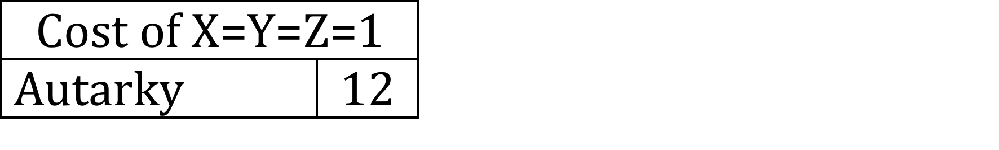
Example 2. (General equilibrium)
3 countries, each with same amount of labor
3 industries (but 6 goods)
Goods demanded in fixed proportions (X=Y=Z)
Each industry has separate input & output
Constant labor requirements (a la Ricardo)
Country A |  |  |  |  | Country B |  |  |  |  | Country C
 | In | Out | Tot |  |  | In | Out | Tot |  |  | In | Out | Tot
X | 1 | 2 |  |  | X | 3 | 1 |  |  | X | 2 | 3
Y | 2 | 3 |  |  | Y | 1 | 2 |  |  | Y | 3 | 1
Z | 3 | 1 |  |  | Z | 2 | 3 |  |  | Z | 1 | 2

Slide 24
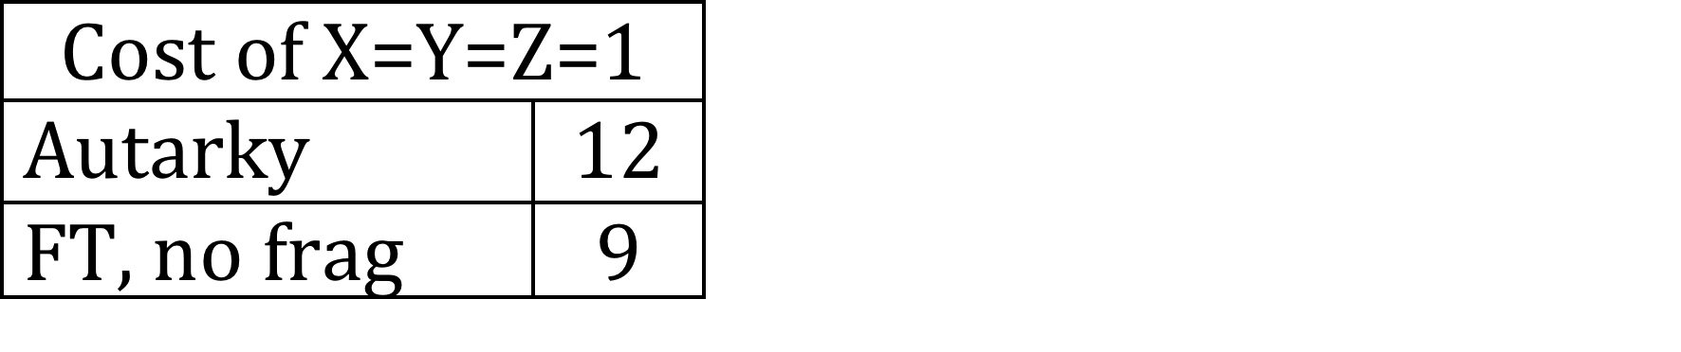
Example 2
Country A |  |  |  |  | Country B |  |  |  |  | Country C
 | In | Out | Tot |  |  | In | Out | Tot |  |  | In | Out | Tot
X | 1 | 2 | 3 |  | X | 3 | 1 | 4 |  | X | 2 | 3 | 5
Y | 2 | 3 | 5 |  | Y | 1 | 2 | 3 |  | Y | 3 | 1 | 4
Z | 3 | 1 | 4 |  | Z | 2 | 3 | 5 |  | Z | 1 | 2 | 3
Comparative advantage if “fragmentation” not possible
  input and output must be produced together,

Slide 25
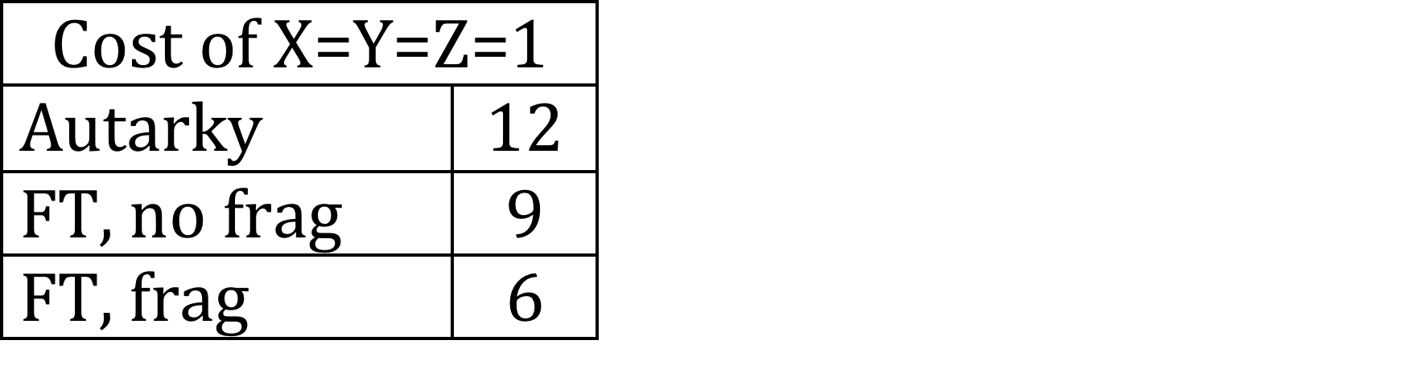
Example 2
Country A |  |  |  |  | Country B |  |  |  |  | Country C
 | In | Out | Tot |  |  | In | Out | Tot |  |  | In | Out | Tot
X | 1 | 2 | 3 |  | X | 3 | 1 | 4 |  | X | 2 | 3 | 5
Y | 2 | 3 | 5 |  | Y | 1 | 2 | 3 |  | Y | 3 | 1 | 4
Z | 3 | 1 | 4 |  | Z | 2 | 3 | 5 |  | Z | 1 | 2 | 3
Comparative advantage if fragmentation is possible and there is multilateral free trade

Slide 26
Example 2
Trade Flows: Inputs
Country A |  |  |  |  | Country B |  |  |  |  | Country C
 | In | Out | Tot |  |  | In | Out | Tot |  |  | In | Out | Tot
X | 1 | 2 | 3 |  | X | 3 | 1 | 4 |  | X | 2 | 3 | 5
Y | 2 | 3 | 5 |  | Y | 1 | 2 | 3 |  | Y | 3 | 1 | 4
Z | 3 | 1 | 4 |  | Z | 2 | 3 | 5 |  | Z | 1 | 2 | 3
Comparative advantage if fragmentation is possible and there is multilateral free trade

Slide 27
Example 2
Trade Flows: Inputs, Outputs
Country A |  |  |  |  | Country B |  |  |  |  | Country C
 | In | Out | Tot |  |  | In | Out | Tot |  |  | In | Out | Tot
X | 1 | 2 | 3 |  | X | 3 | 1 | 4 |  | X | 2 | 3 | 5
Y | 2 | 3 | 5 |  | Y | 1 | 2 | 3 |  | Y | 3 | 1 | 4
Z | 3 | 1 | 4 |  | Z | 2 | 3 | 5 |  | Z | 1 | 2 | 3
Comparative advantage if fragmentation is possible and there is multilateral free trade

Slide 28
Example 2
Trade Flows: Inputs, Outputs
Country A |  |  |  |  | Country B |  |  |  |  | Country C
 | In | Out | Tot |  |  | In | Out | Tot |  |  | In | Out | Tot
X | 1 | 2 | 3 |  | X | 3 | 1 | 4 |  | X | 2 | 3 | 5
Y | 2 | 3 | 5 |  | Y | 1 | 2 | 3 |  | Y | 3 | 1 | 4
Z | 3 | 1 | 4 |  | Z | 2 | 3 | 5 |  | Z | 1 | 2 | 3
But note that some of these exports (in red) use inputs from a third country.
They may not satisfy ROOs, once FTAs exist

Slide 29
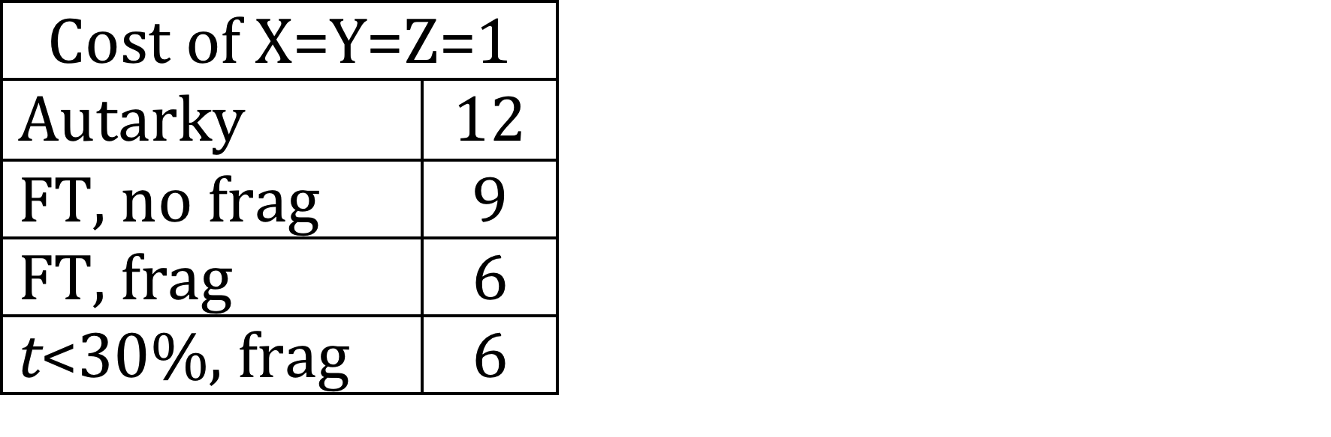
Example 2
Trade Flows: Inputs, Outputs
Country A |  |  |  |  | Country B |  |  |  |  | Country C
 | In | Out | Tot |  |  | In | Out | Tot |  |  | In | Out | Tot
X | 1 | 2 | 3 |  | X | 3 | 1 | 4 |  | X | 2 | 3 | 5
Y | 2 | 3 | 5 |  | Y | 1 | 2 | 3 |  | Y | 3 | 1 | 4
Z | 3 | 1 | 4 |  | Z | 2 | 3 | 5 |  | Z | 1 | 2 | 3
Note: Even with ad valorem tariff, t, on all trade,
if t < ~30%, result is same as with Free Trade (FT),
since t is less than cost advantage
E.g., B’s price of X to A: 1.3(1+1.3(1)) = 2.99 < 3

Slide 30
Example 2
Trade Flows:
Country A |  |  |  |  | Country B |  |  |  |  | Country C
 | In | Out | Tot |  |  | In | Out | Tot |  |  | In | Out | Tot
X | 1 | 2 | 3 |  | X | 3 | 1 | 4 |  | X | 2 | 3 | 5
Y | 2 | 3 | 5 |  | Y | 1 | 2 | 3 |  | Y | 3 | 1 | 4
Z | 3 | 1 | 4 |  | Z | 2 | 3 | 5 |  | Z | 1 | 2 | 3
Now suppose:
  3 bilateral FTAs
  ROOs inhibit output-trades shown by red arrows
    How? Depends on tariffs & ROOs.
    ROO content requirement > 50% and t > 50%
      ROO > 50% since In_{A}/P_{X}(In_{A}) = 50%
      t > 50% raises P_{X}(In_{A}) > 3 = P_{X}(In_{C})

Slide 31
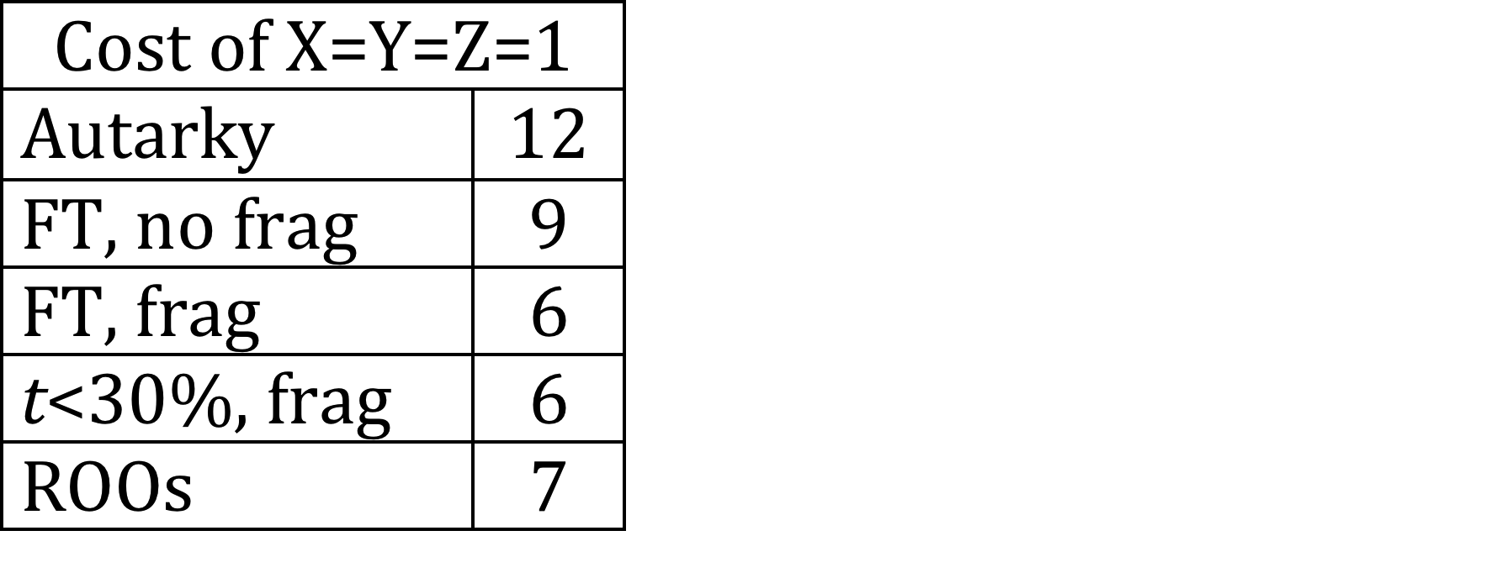
Example 2
Trade Flows: Inputs, Outputs
Country A |  |  |  |  | Country B |  |  |  |  | Country C
 | In | Out | Tot |  |  | In | Out | Tot |  |  | In | Out | Tot
X | 1 | 2 | 3 |  | X | 3 | 1 | 4 |  | X | 2 | 3 | 5
Y | 2 | 3 | 5 |  | Y | 1 | 2 | 3 |  | Y | 3 | 1 | 4
Z | 3 | 1 | 4 |  | Z | 2 | 3 | 5 |  | Z | 1 | 2 | 3
Those trades will instead be sourced within FTAs
Cost rises by 1 unit; world loses.
Cost for 1-unit bundle of X, Y, & Z rises 6➔7
Loss of GDP due to FTAs, compared to free trade: 1/6

Slide 32
Implication (not surprising)
ROOs can reduce the gains from ubiquitous FTAs below global free trade.

Slide 33
Implication?
Question: Can ROOs actually cause the net welfare effect of FTAs to be negative (compared to positive tariffs and no FTAs)?
  In this example, No.
    Needed t < 30% to get free-trade welfare
    Needed t > 50% to induce higher-cost sourcing
  But with different numbers, Yes.

Slide 34
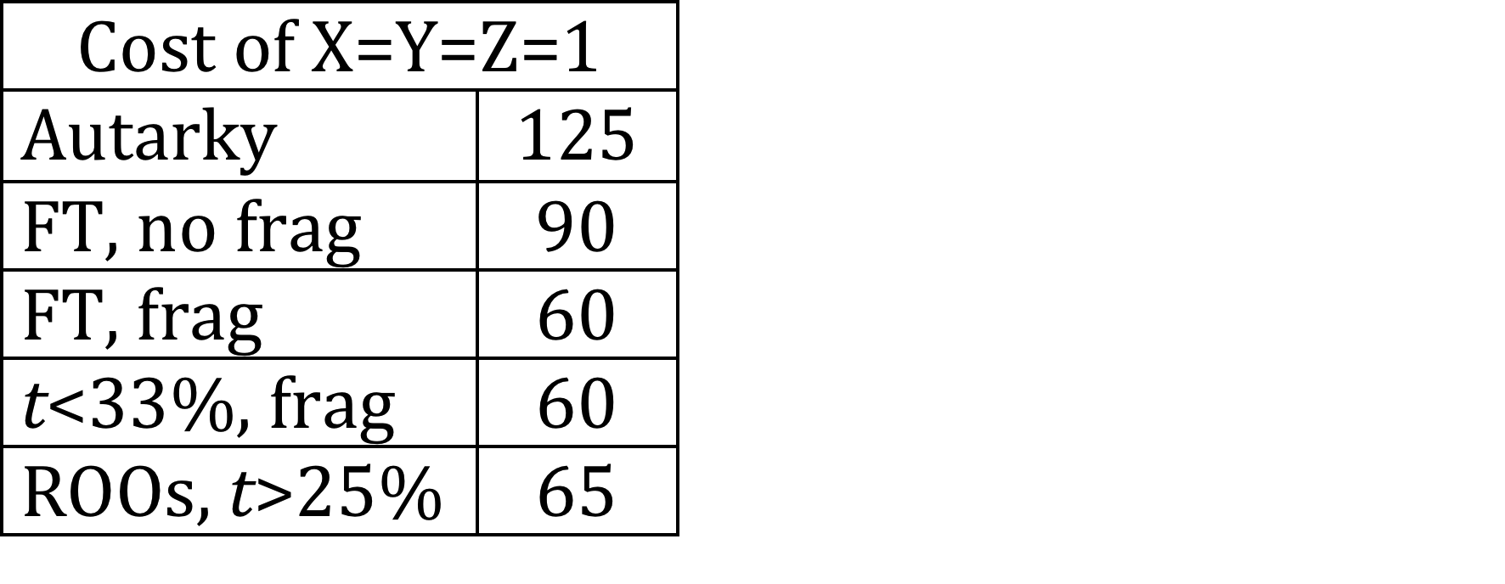
Example 2
Example 3.
Country A |  |  |  |  | Country B |  |  |  |  | Country C
 | In | Out | Tot |  |  | In | Out | Tot |  |  | In | Out | Tot
X | 10 | 30 | 40 |  | X | 20 | 10 | 30 |  | X | 15 | 40 | 55
Y | 15 | 40 | 55 |  | Y | 10 | 30 | 40 |  | Y | 20 | 10 | 30
Z | 20 | 10 | 30 |  | Z | 15 | 40 | 55 |  | Z | 10 | 30 | 40
Numbers here are a different, but patterns of trade are the same.
Tariff between 25% and 33% yields result
E.g., t=30%

Slide 35
Example 2
Example 3.
Country A |  |  |  |  | Country B |  |  |  |  | Country C
 | In | Out | Tot |  |  | In | Out | Tot |  |  | In | Out | Tot
X | 10 | 30 | 40 |  | X | 20 | 10 | 30 |  | X | 15 | 40 | 55
Y | 15 | 40 | 55 |  | Y | 10 | 30 | 40 |  | Y | 20 | 10 | 30
Z | 20 | 10 | 30 |  | Z | 15 | 40 | 55 |  | Z | 10 | 30 | 40
Check that t=30% works:
  (Check for X only; Y and Z are symmetric)
Without FTAs
  B buys X_{IN} for 1.3(10) = 13
  B’s cost of X = 13+10 = 23
  A&C buy X from B for 1.3(23) = 29.9 < 40, 55
  (A’s, C’s cost from self)
With FTAs
  If B buys X_{IN} from A for 10
  B’s cost of X = 10+10 = 20
  If C buys X from B, it pays 1.3(20) = 26 > 25
  (B’s cost with X_{IN} from C)

Slide 36
Example 2
Example 3.
Country A |  |  |  |  | Country B |  |  |  |  | Country C
 | In | Out | Tot |  |  | In | Out | Tot |  |  | In | Out | Tot
X | 10 | 30 | 40 |  | X | 20 | 10 | 30 |  | X | 15 | 40 | 55
Y | 15 | 40 | 55 |  | Y | 10 | 30 | 40 |  | Y | 20 | 10 | 30
Z | 20 | 10 | 30 |  | Z | 15 | 40 | 55 |  | Z | 10 | 30 | 40
X_{IN} from A
Result of Example 3:
With tariffs on all trade of 30%, consumption bundle requires 5/60 = ~8% more labor with FTAs than without.

Slide 37
Implication (surprising?)
ROOs actually can cause the net welfare effect of ubiquitous FTAs to be negative for all countries, compared to no FTAs and positive tariffs.

Slide 38
Are ROOs better than this, or worse?
Better?
  My examples all assumed that producers moved all inputs into the FTA.
  If they only move just enough to satisfy a ROO, then harm will be less.

Slide 39
Are ROOs better than this, or worse?
Worse? I had
  Only two stages of production: input and output
  Only three goods and countries
Examples in the paper show that cost rises with
  more stages of production, and
  more than three goods and countries

Slide 40
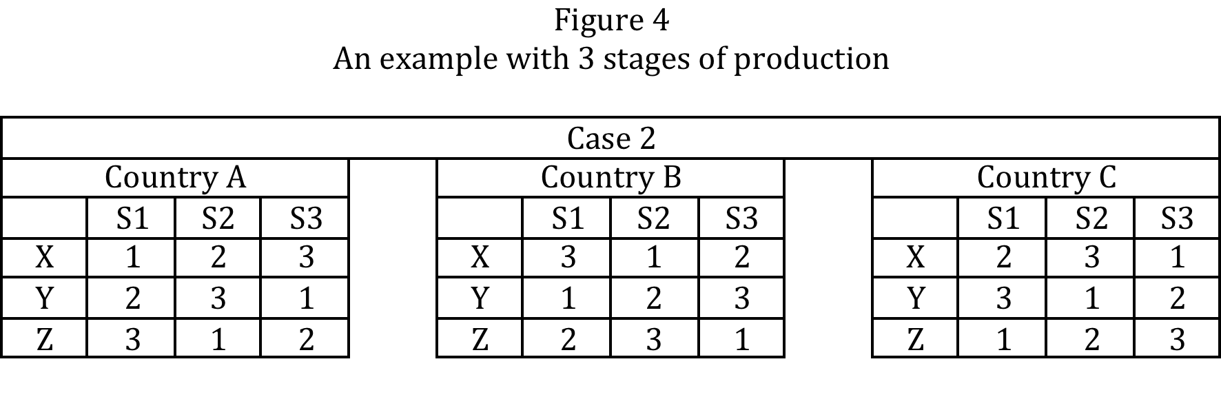
Cost rises from 9 to 11 (22%)

Slide 41
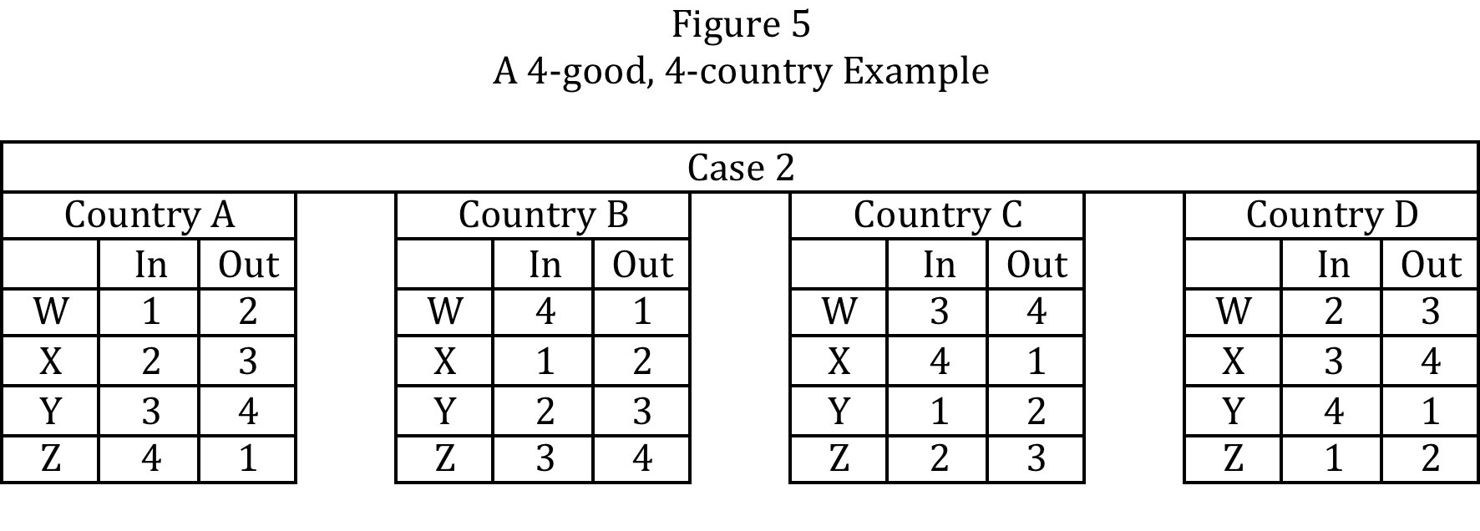
Cost rises from 8 to 11 (38%)

Slide 42
What to Do?
First best: Multilateral free trade (of course)
Second best: greater cumulation
  Specify ROOs so that inputs originating in any FTA partner qualify under other FTAs
Third best: Permit within-FTA tariffs only on portion not originating, not on full value

Slide 43
What to Do?
Is there hope?
  EU seems to use more cumulation than the US
  The proposed Transpacific Partnership (TPP) is (or was) intended to include such cumulation
  Word on the trade street, though, is that the US won’t have it.

Slide 44
Conclusion
The world could
  Choke on spaghetti;
  Or at least get indigestion.

